Slide 1
Culture
Neighbourhood Problems

Slide 2
Lesson Objectives
By the end of the lesson, you will have:
thought about problems people can have in their neighbourhoods
read posts from an online forum
reviewed ways of making suggestions
discussed different neighbourhood problems and shared solutions

Slide 3
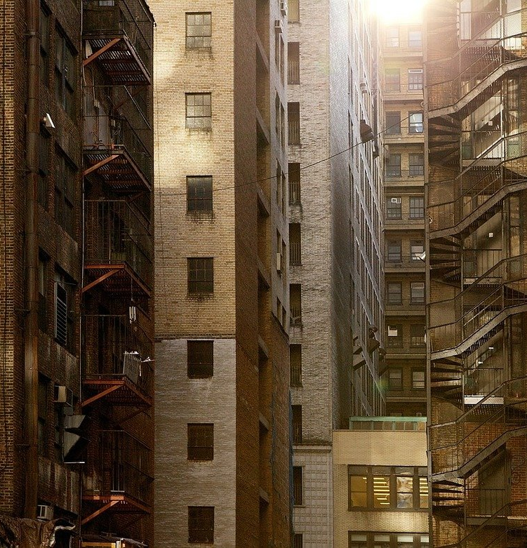
Problems, problems, problems.
What might people complain about where they live?

Slide 4
An online forum
Problems in our Neighbourhoods

Slide 5
Reading
2.1 How many of the problems were the same as the ones you discussed?
What were the problems? Were any solutions suggested?
2.2 Read the posts again and decide if the statements are true or false.
a) Mina wishes her area had more parks.
b) Ivan loves the location of his neighbourhood.
c) Eva and Faaris are fed up with the way all their neighbours behave.
d) Nobody has anything positive to say about where they live.
a) F b) T c) F d) F
What advice would you give to Evi and Faaris?

Slide 6
Adjectives
Tiny
Terrifying
Filthy
Furious
Small
Scary
Dirty
Angry
Modifiers
Absolutely
Really
https://learnenglish.britishcouncil.org/grammar/intermediate-to-upper-intermediate/adjectives-gradable-and-non-gradable

Slide 7
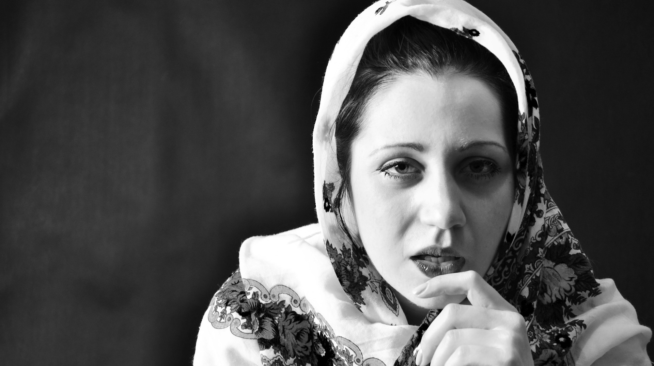
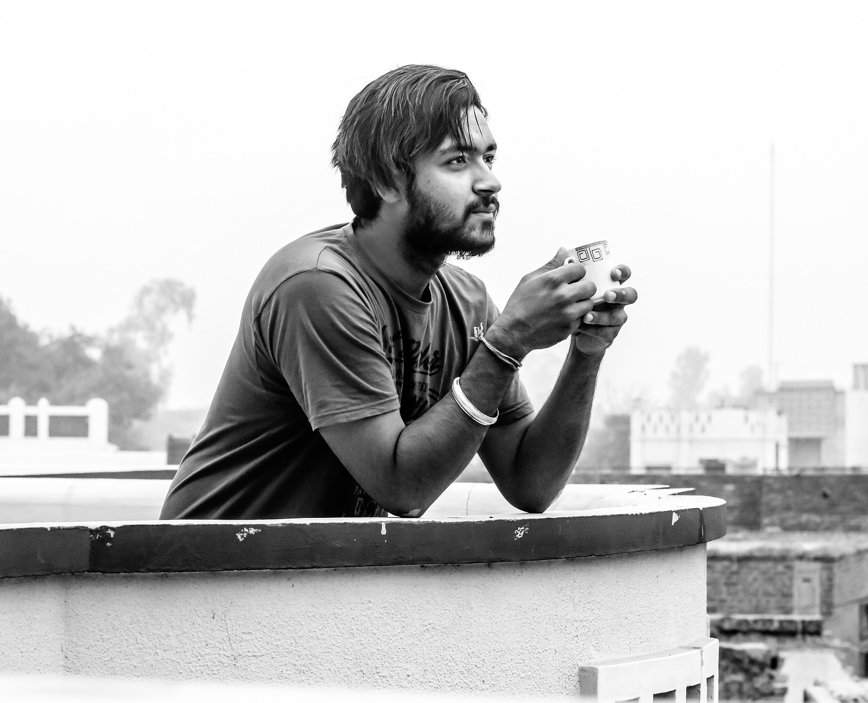
Taking Action
Traffic | Crime | Noise
Neighbours | Animals | Amenities
Making suggestions I suppose you could+ verb I reckon you could + verb I’m not sure but you might +verb | Perhaps you could+ verb It might be an idea to + verb

Slide 8
Reflection Do you think it’s better to take action or do nothing if you have a problem in your neighbourhood? Why? Do you think some people find it easier than others to get help? What might stop people from getting help? What do you think you can do to find out more about how to get help with issues in your neighbourhood?

