Slide 1
Diversity
The Elderly

Slide 2
Learning Outcomes
By the end of the lesson, you will have:
explored your feelings about older people
watched a video challenging stereotypes of older people
discussed age-related situations older people and their families might find themselves in

Slide 3
Being old
Look at the words in the list below. Tick (✓) the top six you associate with older people.
lonely knowledgeable content wasted talent interesting
old-fashioned compassionate technophobe forgetful time-rich
boring invisible unhealthy wise bent
grumpy frightened inspirational experienced wrinkled
Compare your list with a partner. Did you choose focused on mainly positive or negative words? Why?
Can you add any different words to the list?

Slide 4
When do people become old?
Work with a partner to decide when people become ‘old’. Is it when they …
are over 40 / 50 / 60 / 70?
have teenage children?
become a grandparent?
retire?
have wrinkles and lines on their face?
don’t know the music that young people are listening to?
have difficulty hearing, seeing, walking etc.?
something else?

Slide 5
When do people become old?
2. A group of millennials were asked what age they thought was old. What do you think they said?
They were also asked to show how an older person would walk across the street, send a text message, do a push up and a jumping jack. How do you think an older person would do these things? Show the other people in the group.
Now watch the video. Were you right?
Answer these questions:
3. By the end of the video, the millennials had changed their minds. Why?
4. How do the older people in the video feel about being old?
5. Having watched the video, do you want to change your answers to 1.?

Slide 6
Decisions, decisions
Read the situations your teacher gives you. Write the name(s) of the people. You can use each name more than once.
e.g. Who has surprised their family? Maris
Who is sure about their decision?
Maris / Elena
Who has a family member who thinks they are making a bad decision?
Chandra / Kaali
Who has a family member who thinks they are making a good decision?
Giovanni
Who is angry about something?
Sergey / Kaali
Who regrets their decision?
Wilheim
Who thinks a family member is being treated unfairly?
Andre

Slide 7
Taking part in a discussion
Agreeing I’m with you on that. That’s a good point. Disagreeing politely I see what you mean but on the other hand … I take your point however … That’s not always the case / true | Checking what someone is saying You seem to think that … I’m not sure what you are trying to say Why do you think that’s the case?

Slide 8
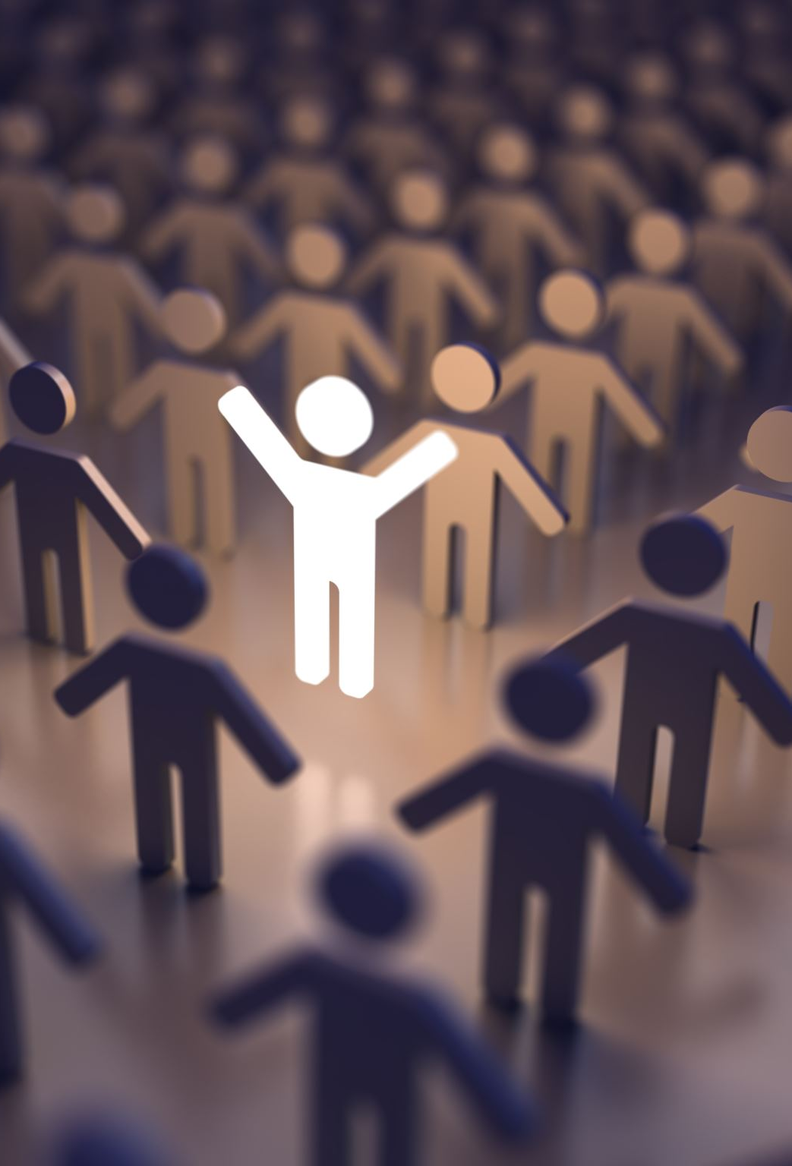
Reflection
Do you think older people are generally treated well? Why? Why not? Does it depend on whether they live?
What sort of problems do elderly people have in today’s society?
How well are elderly people integrated into everyday life?
To what extent are older people treated differently in different places you know?
What can people learn from older people?

